Slide 1

ICEG review group
Open Standards
May 16th, 2022
Marc Bruyland, Rink Kruk & Raf Buyle

Slide 2
Agenda
Presidency of the Council of the EU.

Slide 3
The Belgian Presidency of the Council of the EU: goals
Showing digital leadership
Showcase cooperation model based on a level playing field (cfr. complex state structure; inter-federal Belgium as ideal EU testing ground)
Share and reuse knowledge in the context of the unified data economy and the European Data Spaces

Slide 4
The Belgian Presidency of the Council of the EU: focal points
Administration
European, federal, regional and local administrations
Involve citizen science initiatives
Hosting Interoperable Europe
Political
EU summit with ministers of digitisation
All european citizens
Other member states involved (citizens, ….)

Slide 5
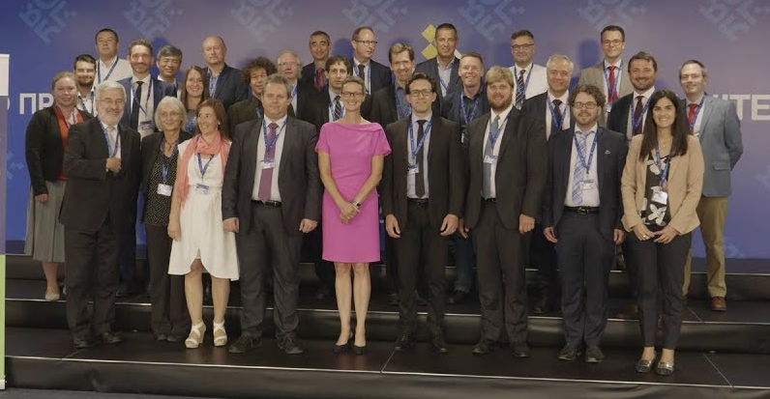
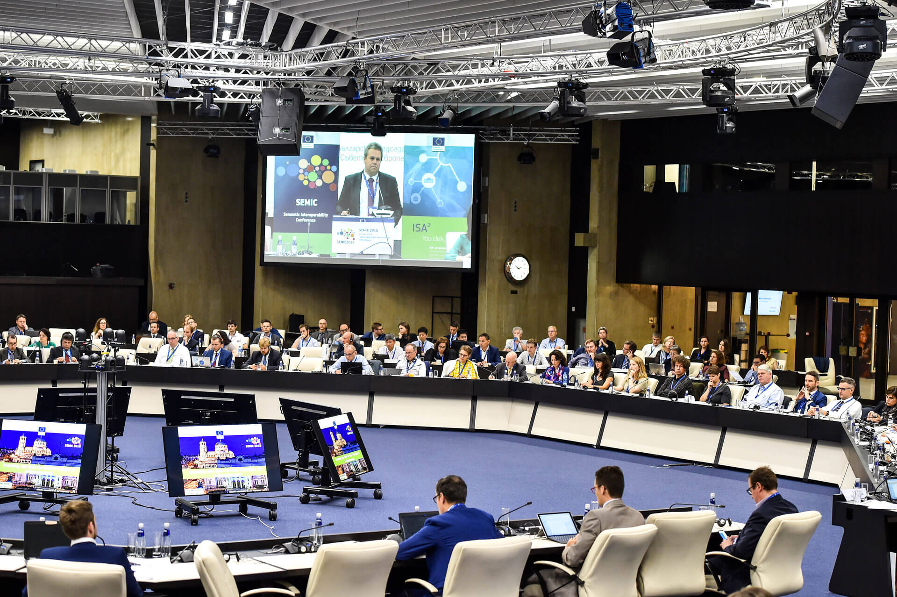
Hosting Interoperable Europe
Coverage 2018: 200 offline & 700 people online

Slide 6
Hosting Interoperable Europe
Umbrella
European Commission > Directorate-General for Informatics > Digital Services (DIGIT.D)
Director: Natalia ARISTIMUNO PEREZ
Focal points
Unified data economy
European Data Spaces
Citizen science initiatives

Slide 7
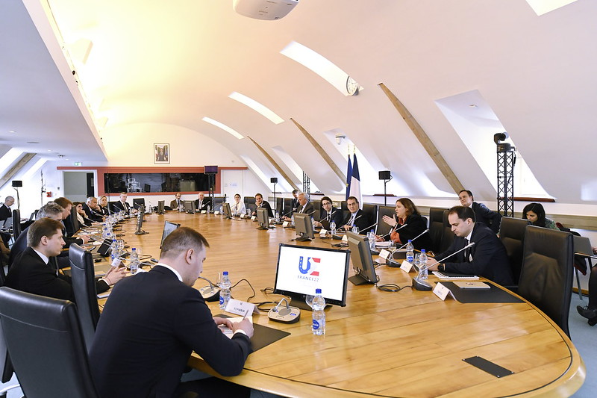
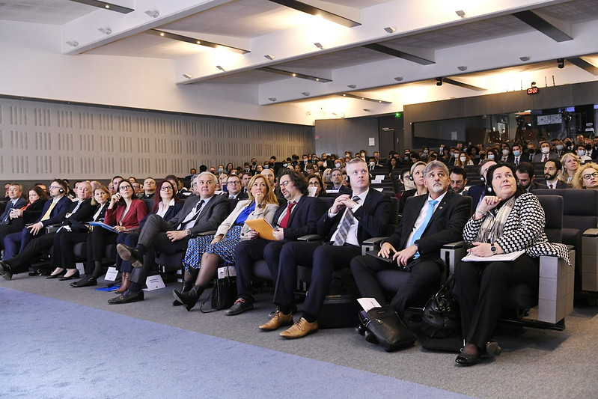
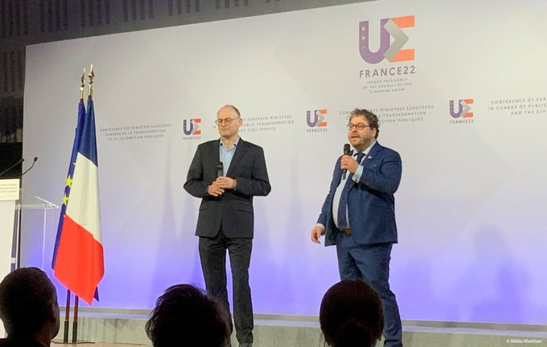
EU summit with ministers of digitisation (France, Strasbourg - March 2022)
Conference with the ministers in charge of digitisation (March 2022).
Tech for Government Pitch, (Administration, March 2022)

Slide 8
EU summit with ministers of digitisation
Similar events
March, 2022, Strasbourg, France
Competition member states, 7 selected, meet and greet with all ministers of digitization + online conference
Intervision of the ministers
Our approach
Similar concept
Involve all policy areas in the competition (focus on key societal challenges such as climate, security, energy... instead of one policy domain)
Possibly expand to a hacketon or an event with students (e.g. open summer of code)
Open for discussion...

